Slide 1
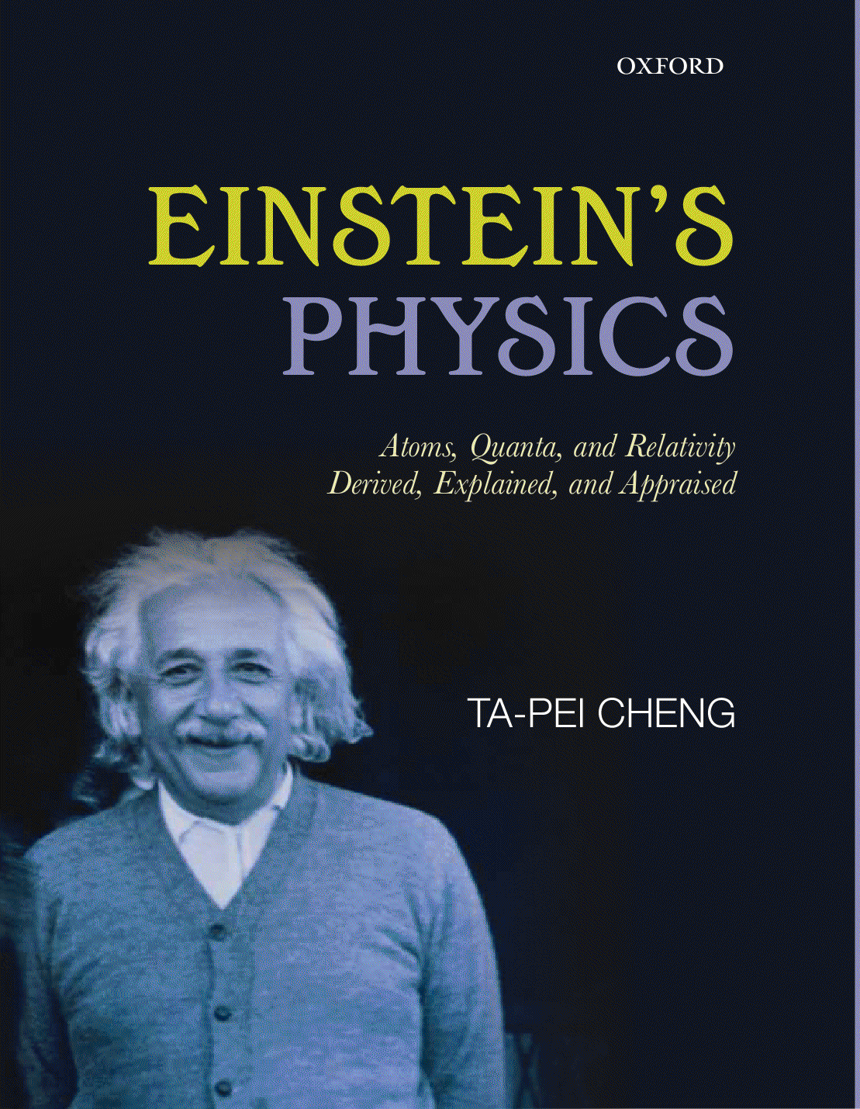
October, 2018 TP Cheng
All about the Einstein Speed
We call c the speed of light Actually, ...
Relativity
c is also that of gravity waves,
the criteria of Newtonian mechanics v << c,
much more, ...
should be The Einstein Speed
→ space and time on equal footing c = the conversion factor
→ New kinematics
c = the key element of the physics arena: 4D spacetime
Not just EM, but all of physics

Slide 2
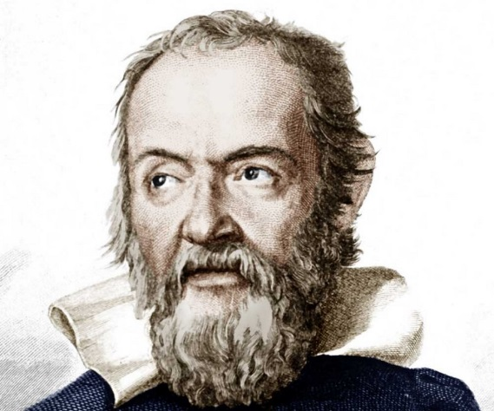
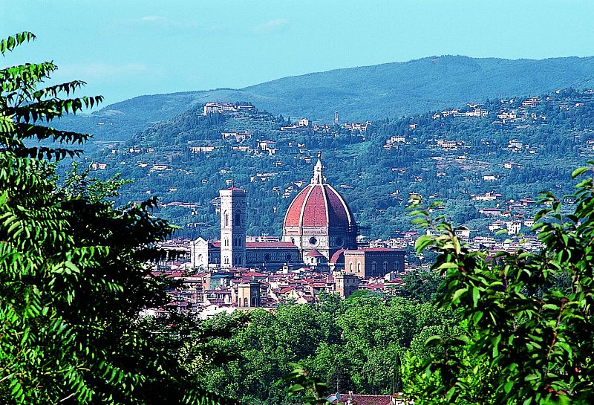
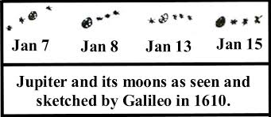
Light propagates at a finite speed?
Suggest
Galileo 1564 -- 1642
Galileo’s stationed himself on one hilltop, and an assistant on a distant hilltop, each armed with a lamp that could be covered and uncovered at will
A great distance will be needed in order to measure
the propagation time
for light that has traveled
Astronomy?!

Slide 3
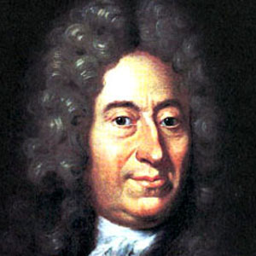
Ole Roemer, the first person to measure c
In late 17 century, the Danish astronomer compiled @ Paris Observatory extensive observation of orbit of Io, Jupiter’s innermost satellite, which is eclipsed by Jupiter once every orbit (1.769 Earth-days).
By timing these eclipses over several years, originally an attempt to establish a sort of “clock-in-the-sky”, something peculiar was observed:
The time intervals between successive eclipses varied with the Earth’s season!
They became steadily shorter as the Earth moved toward Jupiter and became steadily longer as the Earth moved away from Jupiter

Slide 4
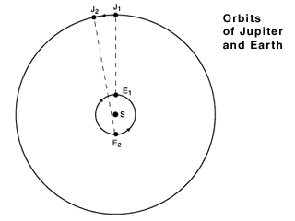
Ole Roemer, the first person to measure c
The eclipse periods became steadily shorter as the Earth moved toward Jupiter and became steadily longer as the Earth moved away from Jupiter
Roemer: The changing intervals are due to the changing position of the Earth & due to a finite c.
c can be deduced:
$∆T$ = the time difference between the longest observed interval and the shortest (6mo later). Thus, it represents the extra time the light needed to transverse the Earth’s orbit
c = 4 AU/$∆T$
AU $≡$ Earth orbital radius $modern value≈150 million km$
$∆T$ $≈22 min$
Orbits of Jupiter & Earth
→ The first quantitative estimate c $≈$ 4 x 10⁵ km/s
In the right ballpark!!
1 Jupiter year $≈$12 Earth yr

Slide 5
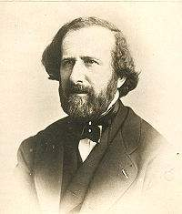
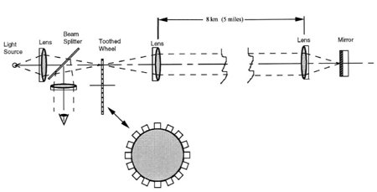
Given the astronomical estimate
→ The required long-distance and short-time intervals for an experimental measurement
First terrestrial measurement
1862
$≈$UM-St Louis to Forest Park
Armand Fizeau
After a 5% improvement by Foucault arrived at the modern value of ${3×10}^{8}m/s$
fast-rotating toothed wheel to measure
short time intervals

Slide 6
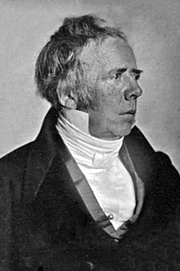
Parallel devlopment
Discovery of electromagnetism
Electricity (electrostatics)
Galvanism (currents & battery)
Magnetism(compass, lode stone)
The connection of Electricity & magnetism
discovered (4/21/1820)
Hans Christian Oersted
$\begin{matrix} \\ Magnetic force \\ \end{matrix} \left\{ \begin{matrix}created by \\ \\ acts on\end{matrix} \right\} \begin{matrix} \\ moving charges \\ \end{matrix}$
Electric current $→$ Magnetic field

Slide 7
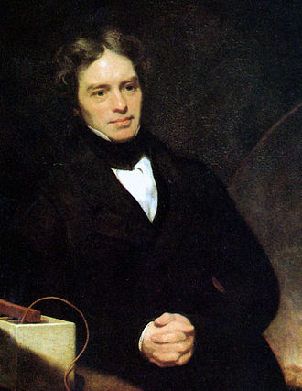
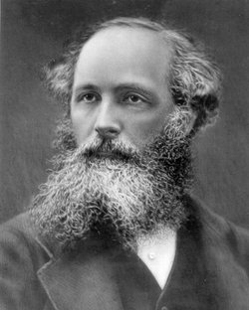
Electromagnetism in terms of electric field E & magnetic field B instead of action-at-a-distance force
Faraday’s law of induction
Changing magnetic field induces an electric field
$\frac{∂B}{∂t}$ $→E$
Principle behind electric generator → turning EM into everyday usage
Michael Faraday
Changing electric field induces a magnetic field
Maxwell’s displacement current
$\frac{∂E}{∂t}$ $→B$
As it’s small effect suppressed by small coeff
discovery made through theory
by requiring the equations to respect
“electric charge conservation”
James Clerk Maxwell

Slide 8
Eqns of electromagnetism
“Maxwell’s equations”
Leading to a wave equation $→$ EM waves
$\frac{∂E}{∂t}$ $→B$
$\frac{∂B}{∂t}$ $→E$
Max eqn: shakng charges → electromagmetic waves
1865
propagating with the speed
$\sqrt{\frac{1}{ε_{o}μ_{o}}}=3×{10}^{8}m/s$
Maxwell: Light is a form of electromagnetic radiation
$=c$
just the speed of light that had been measured
$ε_{o}=$ permittivity (Coulomb’s Law)
$μ_{o}$= permeability (Ampere’s Law)
Not only the unification of electricity and magnetism but also optics
$⅓$T

Slide 9
Maxwell eqns →
EM waves propagate
with a constant speed
$\sqrt{\frac{1}{ε_{o}μ_{o}}}=3×{10}^{8}m/s$
Bizarre!
Normally, expect velocity to be coordinate frame dep
$$u^{′}=u−v$$
$v$ : relative velocity of frames
19c physicists were not so concerned!
They expect EM waves
(like all then-known waves)
to propagate in a medium:
ether
c is the speed in ether’s rest frame
Area of study: Electrodynamics of moving bodies
with respect to ether

Slide 10
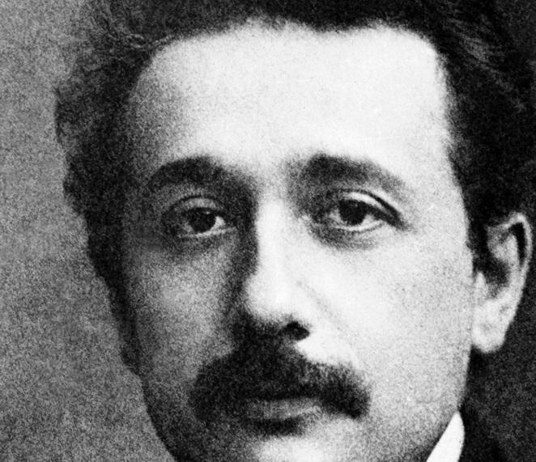
Theory of relativity
“Electrodynamics of moving bodies” 1905 Einstien
Time is not absolute Simultaneity is relative →
Time measured in different frames can be different
Electrodynamics of moving bodies
This allows the same c in all frames
Physics in different coordinate frames are related by Lorentz transformation
→ A new velocity-addition rule
$u^{′}=\frac{u−v}{1−\frac{uv}{c^{2}}}$ $\begin{matrix}\text{u}\text{ = }\text{c}\text{, }\text{then} \text{u}\text{’ = }\text{c} \\ even if v≠0\end{matrix}$
Invariant c as a basic postulate
No
ether is needed!

Slide 11
Einstein’s new conception of time
→ new kinematics
4D spacetime
Time, like space, is observer-dependent
The key message from relativity: Time & Space “on equal footing”
The best way to bring about this symmetry btn space & time is to unite them in a single math structure called spacetime
4D space, with time being the 4th dimension
Just as we display the equal-footing of the 3D’s of space by viewing (x, y, z) as the components of a 3D vector
they transform into each other under rotation,
with the invariance of the length $l^{2}={ x}^{2}$ + $y^{2}$ + $z^{2}$
we should now work with (t, x, y, z) as components of a 4D vector so they are transformed into each other by
“rotations” in 4D spacetime, which is just Lorentz transformation
The arena of physics is 4D spacetime

Slide 12
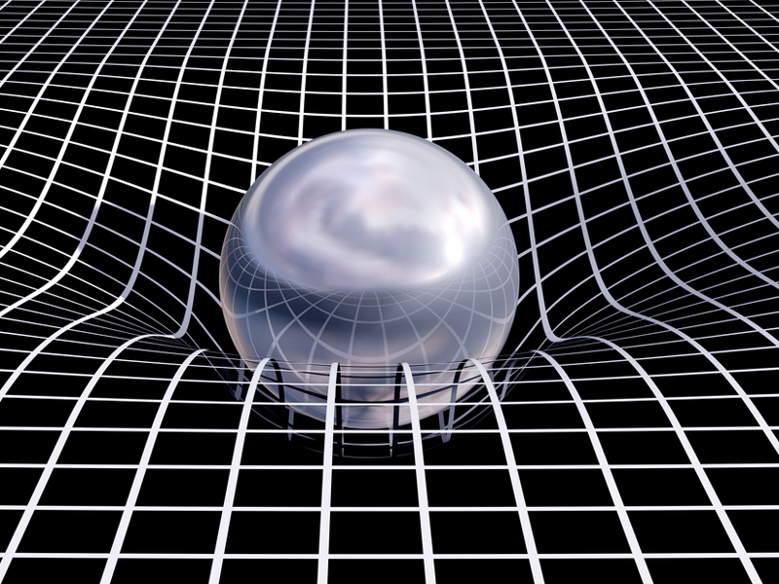
4D spacetime
The new kinematics
The arena of physics is 4D spacetime
Physics quantities = 4D tensors, Phys eqns = tensor eqns
“Covariance” of eqn → automatically has the symmetry of relativity
Relativity not just for electromagnetism but for all of physics
Mechanics equations must be modified
Newtonian mech valid only for v << c
Maxwell’s eqns are already relativistic,
Newton’s theory of gravity is not
Einstein’s theory of gravitation
General Relativity
gravity = curvature of 4D spacetime
Spacetime description is indispensable

Slide 13
c = a conversion factor
Space (x,y,z) have different dimensions from time
one must introduce “c” as the conversion factor so that
4D vector components (ct, x, y, z) can have the same dim‘s (units)
& rotation leaves invariant the “length”$s^{2}={ −c^{2}t^{2}+x}^{2}$ + $y^{2}$ + $z^{2}$
An example of $fundamental constants$ as conv fac
$allow us to connect disparate realms of physics$
c = the conversion factor relating time and space
$much like$
$Planck constant h$relates waves to particles,
Newton constant g_{N}: mass-energy-momentum to curvature of spacetime
E’s field eqn
$G_{αβ}=g_{N}$ $T_{αβ}$

Slide 14
c = the standard & limiting speed
4D displacement vector (ct, x, y, z)
with invariant length${ −c^{2}t^{2}+x}^{2}$ + $y^{2}$ + $z^{2}=−c^{2}τ^{2} proper time$
→ 4D momentum vector ($\frac{E}{c}$, $p_{x}$, $p_{y}$, $p_{z}$)
with invariant length $−\frac{E^{2}}{c^{2}}+p_{x}^{2}+p_{y}^{2}$ $+p_{z}^{2}$ = $−\frac{E^{2}}{c^{2}}+p^{2}=−c^{2}m^{2}$
$$Relativistic energy \& momentum$$
$p=γmv$ $E=γmc^{2}$ limiting v < c
$$γ=\frac{1}{\sqrt{1−\frac{v^{2}}{c^{2}}}}$$
mass-indep ratio: $\frac{pc}{E}$ = $\frac{v}{c}$
$$\frac{v}{c} →0, γ→1$$
$$Newtonian$$
Massless particles m = 0 : E = pc
v = c
always move at the speed c
standard, limiting

Slide 15
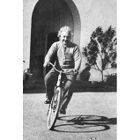
c is much more than the speed of light
The invariant speed of relativity
The limiting & standard speed (v $≤c, \frac{v}{c}→0 Newtonian$ physics)
$$\frac{E^{2}}{c^{2}}$$
$$\frac{E^{2}}{c^{2}}$$
The conversion factor btn space & time
new kinematics
applicable to all physics
The Einstein Speed
⅔T
15

Slide 16
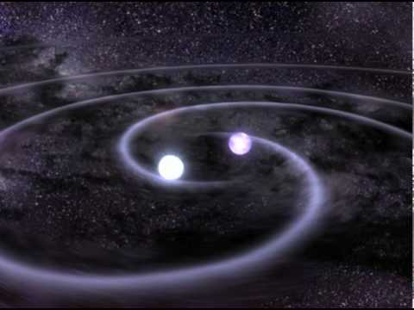
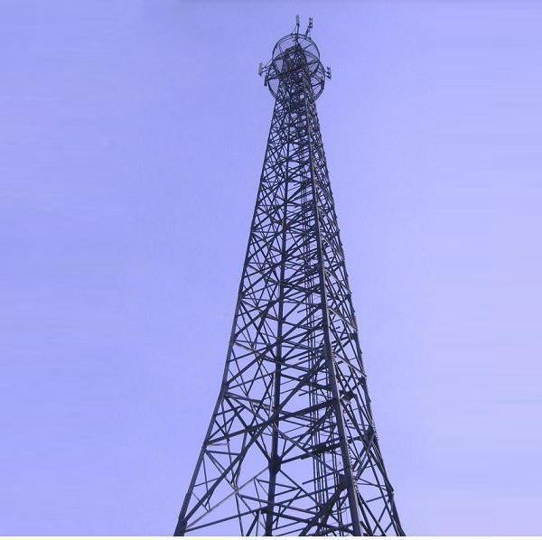
Light and gravitational waves propagate at the same speed c Why? Direct connection
btn EM & gravity?
Einstein eqn: shaking masses → gravitational waves
Maxwell eqn:
shaking charges → electromagnetic waves
Besides saying “they obey similar relativistic wave equations → speed c”
will present a round-about (but better?) explanation

Slide 17
Quantum field theory description of forces
Quanta of a field = particles, Q of EM field = photons
In QFT, forces are depicted as due to the exchange of particles
Electromagnetic force is transmitted by photons
Gravity by gravitons
as QM allows the spontaneous
creation and destruction of particles
The uncertainty principle $∆E ∆t ≥h$
E$nergy conservation can be violated by the amount of ∆E$
as long as it take place within the time interval$∆t$

Slide 18
Range of a force is determined by the mass of the exchanged particles
Forces are depicted as due to the exchange of particles: spontaneously created and destroyed $∆E=mc^{2}$
$$The uncertainly principle ∆E ∆t ≥h→existence of a "virtual particle" is allowed for a time interval ∆t≤\frac{h}{mc^{2}}$$
Range of the force = the max distance the created particle can travel
$$R=c∆t≤\frac{h}{mc}$$
$$Nuclear force has a \left(short\right)range R≈1 fm={10}^{−15}m$$
1935 Yukawa predicted its $carriers$ $m_{π}≈100 MeV$
Electromagnetic and gravitational forces are LONG RANGE
$$R=∞ → m=0$$
Carriers of EM, Gravity (photons, gravitions)
must be massless particles → always moving at c
relativity

Slide 19
The observational evidence for the equality of EM & grav wave propagation speeds ?
$\frac{c_{grav}}{c}=$1$\begin{matrix}+0.0000000000000007 \\ −0.000000000000003\end{matrix}$

Slide 20
August 17, 2017 LIGO & Virgo detected gravitational waves
1.7 sec later Fermi-$γray$-SpaceTelescope detected gamma ray burst
… + 70 other optical, radio wave telescopes,..
The source:
Kilonova → the production of
precious metal elements: Ag, Au, Pt, …
The merger of 2 neutron stars that took place
130 million years ago
… Yet its gravitational and EM signals arrived within the predicted time interval

Slide 21
Thus not only theory, we have the observational evidence for the equality of EM & grav wave propagation speeds
$\frac{c_{grav}}{c}=$1$\begin{matrix}+0.0000000000000007 \\ −0.000000000000003\end{matrix}$

Slide 22
To reiterate:
Q
Why do gravitational waves propagate at the same speed as light?
A
Gravity & EM interactions are long range forces
Long range forces, according to QFT, are transmitted by massless particles
Theory of relativity → zero mass particles
always propagate at the Einstein speed c
Hence the equality of c_{grav}= c$γ$ = c
Not only theory, we also have strong observational evidence for c_{grav}= c$γ$
Fundamentally, c is the conversion factor
btn space and time; a key element of 4D spacetime

