Slide 1
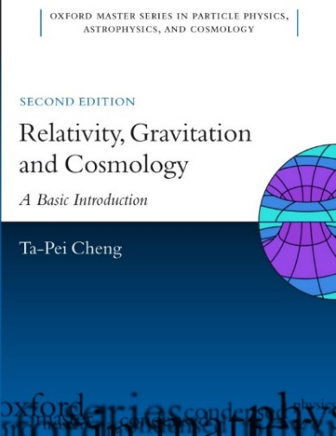
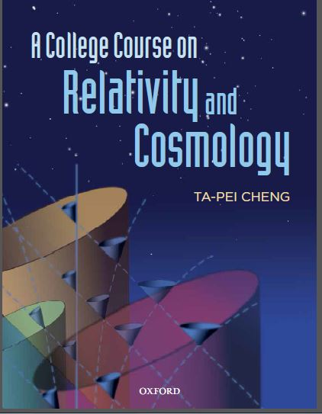
T P Cheng
Zoom presentation at 2019 Miami Conference
Based on a talk prepared for the 2017 eclipse meeting
Einstein, bending of light
& the 1919 solar eclipse
Pedagogy for an undergraduate GR course
Relativity, black holes & cosmology
for math-shy students

Slide 2
‘Physics first’ approach to the teaching of GR
introducing difficult math gradually so that students get to
study the interesting physical applications at an early stage
Equivalence Principle
Gravitational time dilation, GPS
Bending of a light ray
EP physics → Einstein’s idea: gravity = spacetime curvature
Schwarzschild spacetime
GPS & Light deflection again
EP → physics
→ Curved spacetime → new physics

Slide 3
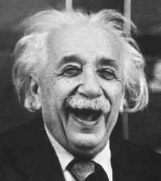
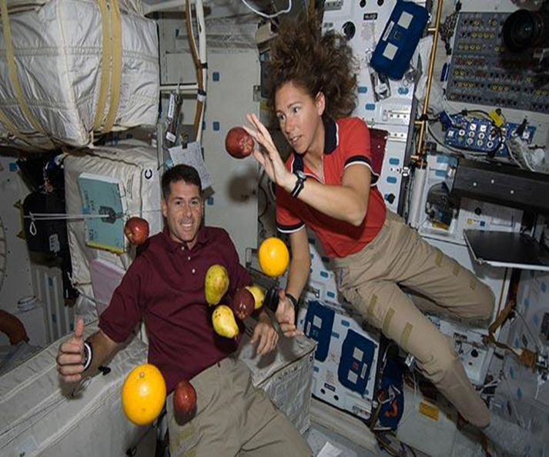
Einstein: my happiest thought
1907 while writing
a review article
on relativity,
Einstein started thinking of
a relativistic theory of gravitation
This Equivalence Principle was extended to all of physics
ie, beyond $m_{I}=m_{G} of mechanics$
2 application examples: grav time dilation & GPS
He recalled the fundamental Galilean observation: in a gravitational field
all objects fall with the same acceleration
and came to the deep insight:
Since all bodies accelerate in the same way, an observer in a freely falling lab
sees no gravity!
Gravity is transformed away
locally in a free-fall frame
Special relativity is applicable in such a case
3

Slide 4
Equiv Principle →
Gravitational time dilation
The usual approach: Comparison of times by exchange of light signals: gravitational redshift --> gravitational time dilation
A more direct way …
In this free-fall, no-gravity, frame
${dt}_{3}$ can be related to ${dτ}_{1}and {dτ}_{2}$
via SR time dilation due to relative motion
$$γ_{1}{dτ}_{1}={dt}_{3}=γ_{2}{dτ}_{2} where γ_{i}={\left(1−u_{i}^{2}/c^{2}\right)}^{−1/2}$$
→ $\frac{{dτ}_{1}}{{dτ}_{2}}=\frac{γ_{2}}{γ_{1}}≅1−\frac{1}{2}\frac{u_{1}^{2}−u_{2}^{2}}{c^{2}}=1+\frac{Ф_{1}−Ф_{2}}{c^{2}}$
Grav time dilation
Stationary Clocks-1 & -2 @ $Φ_{1,2}$
Clock-3 in free fall
Passing clock-1 @ speed $u_{1}$
Passing clock-2 @ speed $u_{2}$
${dτ}_{1}=dτ$ at $Ф_{1}$=$Ф; {dτ}_{2}=dt$ at $Ф_{2}$= 0
$$\frac{dτ}{dt}=1+\frac{Ф}{c^{2}}$$

Slide 5
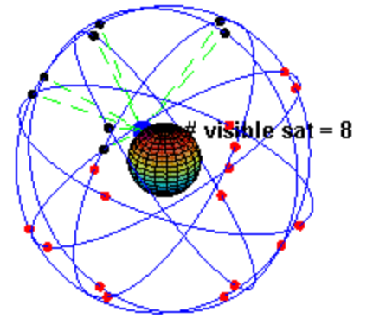
Global Position System
To fix a location r on earth 24 satellites in 6 orbits → at least 4 over the horizon
Distances obtained from
timing measurements of EM signals
need extremely precise information of the transmission time
Picture source: Wikipedia
Time can be measured by atomic clocks… BUT satellites are high up in space (ie diff grav pot)
and moving with high speed
must take grav & SR time dilations into account!
$$⊕$$
relativistic corrections: terrestrial vs satellite (S) times

Slide 6
EP → bending of a light ray
n
Equivalence Principle
→ even the vacuum, with gravity, can have
an effective index of refraction c(r) $≠$c
Gravit’l time dilation
leads to
a position-dependent light speed
(as measured by coor clock far from source)

Slide 7
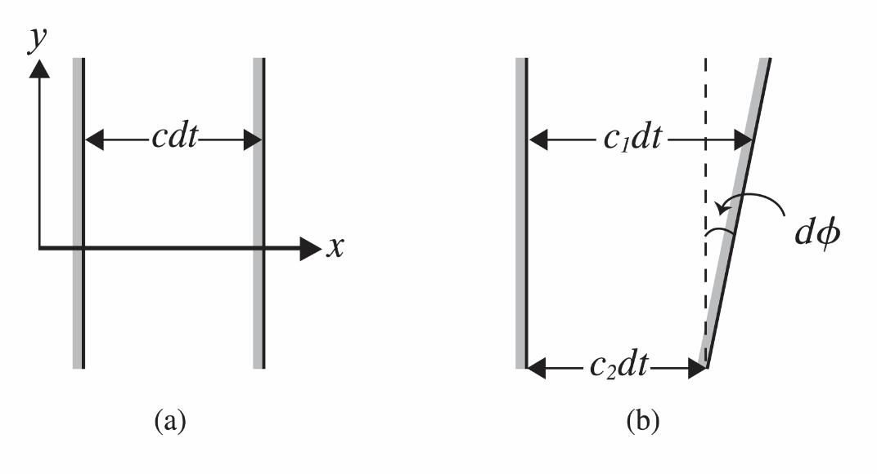
Calculating bending of light
via
Huygen’s construction
g
infinitesimal angle of deflection

Slide 8
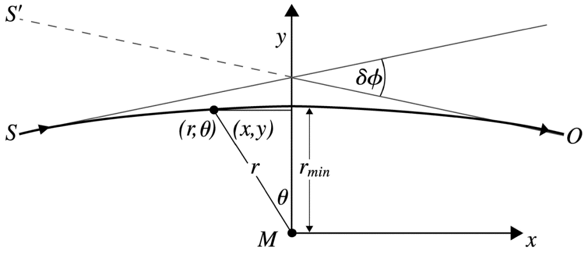
Integrate over the entire path to obtain the total deflection angle
Starlight grazing the sun
Einstein 1911
1914 German eclipse expedition
EP taken into account only grav time dilatlon
Einstein 1915

Slide 9
EP → Einstein’s geometric theory of gravity
EP → physics
→ Curved spacetime → new physics
For example,
gravitational time dilation
= the bending of spacetime
in the time direction
½ way

Slide 10
EP time dilation→ spacetime curved in the time direction

Slide 11
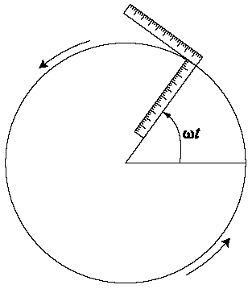
Curved spacetime as gravitational field (some supporting arguments)
A curved space is locally flat
(flatness theorem)
&
Gravity transformed away locally
Curved spacetime
is locally flat
“= no gravity”
in agreement with EP
GR as a metric theory automatically and precisely
incorporates the EP

Slide 12
Metric for a spherically symmetric spacetime has only 2 scalar elements
g_{μν}=$\left(\begin{matrix}g_{00} & \\ & \begin{matrix}g_{rr} & & \\ & r^{2} & \\ & & r^{2}\sin^{2}\text{θ}\end{matrix}\end{matrix}\right)$
Without using high power math such as Killing vectors …
Naturally pick a spherical coordinate system (t,r,θ,φ)
Writing x^{μ}=(ct,r), the infinitesimal invariant ds² = g_{μν}dx^{μ}dx^{ν} must be quadratic in dr and dt without singling out any particular angular direction
ds² = Adr⋅dr + B(r⋅dr)² + Cdt(r⋅dr) + Ddt²
Key concept to learn: The coordinates in Riemannian geometry, as labels of points in the space, can be freely chosen. Have no intrinsic significance until their connection to the physical length ds² is specified by the metric function as in ds² = g_{μν}dx^{μ}dx^{ν}
One is free to choose new coordinates, thereby altering the metric to make it as simple as possible: A,B,C,D --> g₀₀, g_{rr}

Slide 13
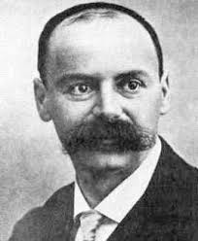
Recall the corresponding
Newtonian spherical solution:
Spherically symmetric spacetime solution to the Einstein field equation
$Φ=−GM/$r
g_{μν}=$\left(\begin{matrix}g_{00} & \\ & \begin{matrix}g_{rr} & & \\ & r^{2} & \\ & & r^{2}\sin^{2}\text{θ}\end{matrix}\end{matrix}\right)$
Schwarzschild solution
$ds^{2}=c^{2}dτ^{2}{=g}_{00}$ $c^{2}dt^{2}$
Just the gravitational time dilation

Slide 14
back to the operation of GPS
now derived via curved spacetime
Recall EP result: clocks on the ground and on satellites run at different rates
Need to compare the proper time rates recorded by the clocks on the satellite and on earth. The proper time is directly related to the invariant interval with $dr=dθ=0$
(circular orbit on a fixed $θ$-plane)
only $g_{00} comes into$ play
$−c^{2}{dτ}_{ԑ}^{2}=−\left(1+2\frac{Φ_{ԑ}}{c^{2}}\right)c^{2}{dt}^{2}+r^{2}{dφ}^{2}$
after inserting $Φ_{ԑ}=−GM_{ԑ}/r_{ԑ}$
Picture source: Wikipedia
SR result is part of GR
SR time dilation
just part of
the new kinematics
reinforce the point
Schwarzschild geometry
Gravitational time dilate
due to
bending of spacetime
in the time direction
Divide by $−c^{2}{dt}^{2} have {\left(\frac{dτ_{ԑ}}{dt}\right)}^{2}=\left(1+\frac{{2Φ}_{ԑ}}{c^{2}}\right)−{\left(\frac{rdφ}{cdt}\right)}^{2}$
Square root & use $v=\frac{rdφ}{dt},$get
$\frac{dτ_{ԑ}}{dt}$ = $1+$ $\frac{Φ_{ԑ}}{c^{2}}−$ $\frac{{v_{ԑ}}^{2}}{2c^{2}}$
Similarly, for satellite $\frac{dτ_{s}}{dt}$ = $1+$ $\frac{Φ_{s}}{c^{2}}−$ $\frac{{v_{s}}^{2}}{2c^{2}}$
their ratio

Slide 15
$${ back to g}_{rr}$$
GR treats space and time
on equal footing
Curving also in spatial as well as in temporal direction
Instead just saying:
besides curving in the time direction, GR indicates also curvings in the spatial directions as well …
Better: relate the new feature to something more familiar – less abstract ...
$${ with g}_{rr}=\left(1−\frac{2Φ}{c^{2}}\right)$$

Slide 16
$$dρ=\sqrt{g_{rr}} dr$$
In this free-fall no-gravity frame
${dr}_{3}$ can be related to ${dρ}_{1}and {dρ}_{2}$
via SR length contra’n due to relative motion
ruler
$$\frac{1}{γ_{1}}{dρ}_{1}={dr}_{3}=\frac{1}{γ_{2}}{dρ}_{2} where γ_{i}={\left(1−u_{i}^{2}/c^{2}\right)}^{−1/2}$$
→ $\frac{{dρ}_{1}}{{dρ}_{2}}=\frac{γ_{1}}{γ_{2}}≅1+\frac{1}{2}\frac{u_{1}^{2}−u_{2}^{2}}{c^{2}}=1−\frac{Ф_{1}−Ф_{2}}{c^{2}}$
ruler
ruler
Grav length contract
$$ρ_{1,} Φ_{1}=ρ, Φ$$
$$ρ_{2,} Φ_{2}=r, 0$$
$$\frac{dρ}{dr}=1−\frac{Φ}{c^{2}}$$
Just matches
the Schwarzschild $g_{rr} term$

Slide 17
Deflection of light from curved spacetime
Grav length contraction
$\frac{1}{\text{n}\text{(}\text{r}\text{)}}$ = $\frac{c(r)}{c}=\frac{\frac{dr}{dt}}{\frac{dρ}{dτ}}=\frac{\frac{dr}{dρ}}{\frac{dt}{dτ}}=\frac{\left(1−\frac{Φ}{c^{2}}\right)}{\left(1+\frac{Φ}{c^{2}}\right)}≅\left(1−\frac{2Φ}{c^{2}}\right)$
Grav time dilation
Deviate from unity twice as much as the EP case
Einstein 1915
Of course, we can derive the same result by way of the usual procedure of using GR eqn of motion, the geodesic eqn

Slide 18
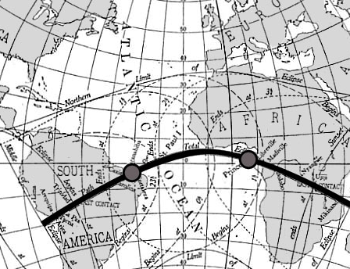
The 1919 solar eclipse expedition
verified the GR prediction
For light grazing the surface of the sun:
$${\left[δφ\right]}_{GR}=\frac{{4GM}_{⊙}}{{c^{2}R}_{⊙}}=1.74"$$
1/4000 of the angular width of the sun,
---- not easy to detect
One needed a solar eclipse against a background of several bright stars (so that some could be used as reference points). On May 29, 1919 there was such a solar eclipse. Two British expeditions were organized by Arthur Eddington and Frank Dyson: one to Sobral in northern Brazil, and another to the island of Principe off the coast of West Africa.
Path of 1919 solar eclipse
with a totality = 6 min 51 sec !

Slide 19
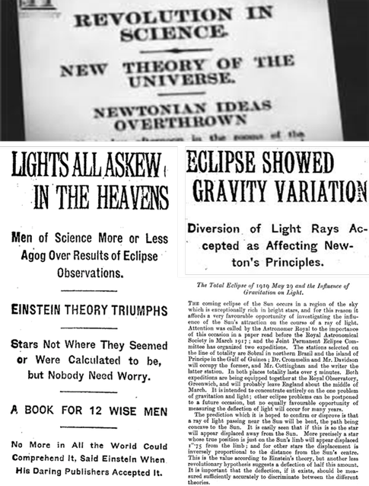
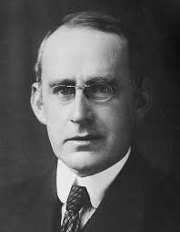
1919 eclipse observ’n
caused a media sensation
making Einstein a global celebrity
This resulted partly for scientific reasons and partly because the world was amazed that so soon after “the Great War" (WW1) the British should finance and conduct an expedition to test a theory proposed by a
German citizen
Eddington was a Quaker pacifist. With the strong support of British astronomy establishment, he was able to continue his research during the War and, through de Sitter in neutral Holland, got Einstein's GR papers in 1916

Slide 20
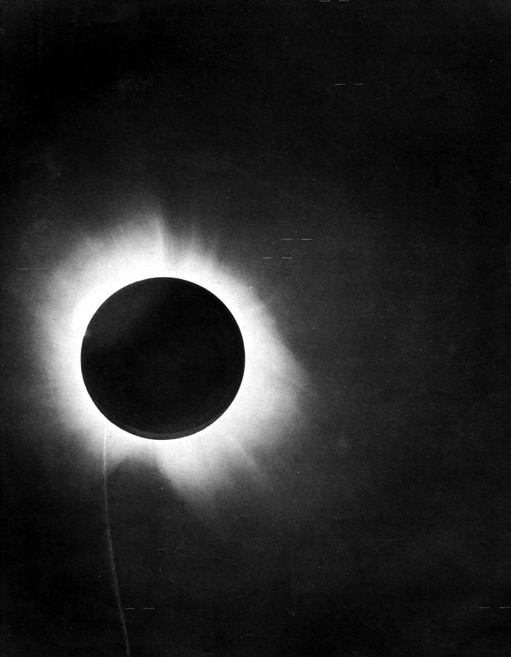
Eddington wrote afterwards:
"The days preceding the eclipse were very cloudy. On the morning of May 29, there was a very heavy thunderstorm from about 10:00 AM to 11:30 AM. The Sun appeared for a few minutes, but the clouds gathered again. About a half hour before totality, the crescent Sun could be glimpsed occasionally, and by 1.55 it could be seen continuously through drifting cloud."

