Slide 1
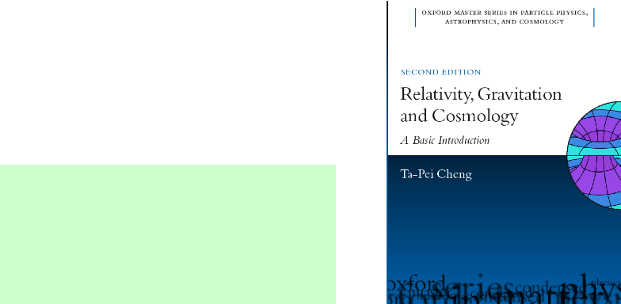
PCNY 9/16/2011
Ta-Pei Cheng
For a more quantitative discussion, see
Relativity, Gravitation & Cosmology:
A Basic Introduction
(Oxford Univ Press) 2nd ed. (2010)
Notes:
Title: The Dark Universe Observed

Slide 2
dark matter & dark energy
Astronomical observations suggest that
most of the mass of the universe is in a mysterious form called dark matter
most of the energy in the universe is in an even more mysterious form called dark energy.
Unlocking the secrets of dark matter and dark energy will illuminate the nature of space and time and connect the quantum with the cosmos

Slide 3
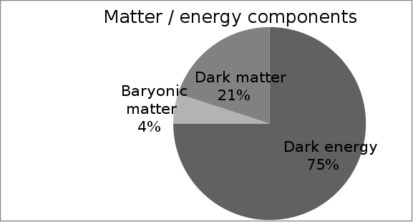
MATTER/ENERGY COMPONENTS OF THE UNIVERSE
BARYONIC MATTER
ordinary matter, can be observed thru their electromagnetic effects
DARK MATTER
no electromagnetic interaction, detected thru their grav.effects
DARK ENERGY
Radiation energy component is negligible

Slide 4
BARYONIC MATTER
Ordinary matter : Atoms = [(p, n) + e]
Protons, neutrons = “baryons”
Baryonic matter emit and/or absorb light
Luminous (stars) + non-luminous (gas, plasma,…) The dominant component = interstellar gas and plasma.
One way to determine the total content of baryonic matter is through the comparison of observation with calculation of big bang nucleosynthesis

Slide 5
BBN 1
Big Bang Nucleosynthesis
Light nuclear elements (H, He, D,…)
created by Big Bang
the universe is expanding, at earlier times
the universe was hotter and denser
Helium were created
in the first three minutes after the Big Bang,
along with trace amounts of other light elements
(deuterium, lithium, etc.)
the correct relative amounts (e.g., 23% helium, as in the Sun) are obtained only if the density of baryonic matter is about 4.0% of the total mass/energy density of the universe
2n+2p→⁴He⁺⁺+γ

Slide 6
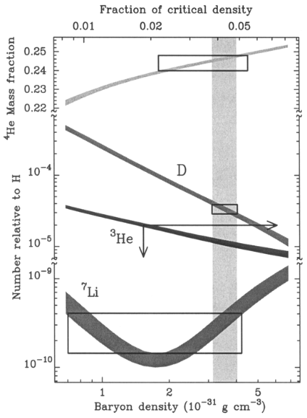
BBN 2
Big Bang Nucleosynthesis
The expected abundance of light nuclear elements are calculated as a function of baryon density
Compared to observed abundance
% of baryon density ≈ 0.043

Slide 7
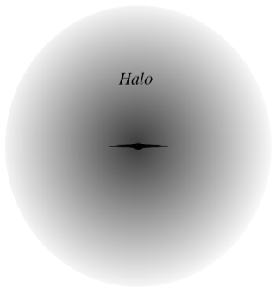
DARK MATTER
Matter, observed thru their grav effects – attractive force
1930’s Zwicky:
Coma cluster of galaxies
1970’s Rubin & Ford:
galactic rotation curves
Gravitational masses of galaxies are generally five times as large as the masses in their stars and gases (baryonic matter) i.e., 80% of matter is dark
Dark matter inevitable?
May be Law of gravity needs to be changed for distant cosmos?
May be the 2 comp matter (BM+DM) assumption is incorrect?
The vast majority of
the matter in the universe is some unknown and invisible collisionless material

Slide 8
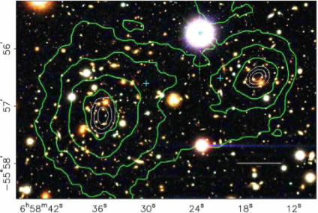
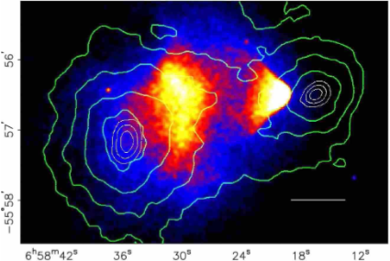
Bullet Cluster resulting from two merging clusters
As direct proof of two matter components, one being collisionless, ie, DM effects not due to altered gravity
Gravitational lensing result (contours) showing dominant mass distribution
HST picture showing galaxies (BM) mostly follow gravitational potential Wells (due to DM)
Chandra X-ray picture showing that the dominant baryonic component (plasma) separated from the main mass distribution

Slide 9
The physical origin of DARK MATTER?
exotic form of matter never found on Earth, in the stars, etc.
DM = some unknown elementary particle that was produced in huge amounts in the Big Bang
Favorite candidate: weakly interacting massive particles CDM = WIMP predicted by some yet-to-be-proven particle physics theories
neutralinos of supersymmetry ?….
active programs searching for CMD particles:
high energy accelerators (LHC, …)
gamma ray satellite telescopes (GLAST,…)
in deep-underground labs.

Slide 10
DARK ENERGY
Observed thru its gravitational effect: repulsive force
Definition, observational evidence, phys origin
General Relativity Einstein’s
theory of gravity

Slide 11
General relativity
SR: Physics arena = 4D spacetime
GR: gravity = structure of spacetime
GR = classical field theory of gravity
source field test body
field eqn
eqn of motion
Electromagnetic field E & B
GR: gravity field = curved spacetime
Spacetime tells matter how to move
Matter tells spacetime how to curve
EM eqn of motion = Lorentz force law
EM field eqn = Maxwell eqns
GR eqn of motion = geodesic eqn
GR field eqn = Einstein eqn

Slide 12
GR: gravity = structure of spacetime mass/energy bring about curvature of ST
GR field eqn = Einstein equation
G_{μν} = g_{N} T_{μν}
geometry mass/energy
It reduces to Newton’s eqn, in NR weak field limit
G_{μν} = curvature tensor 2nd derivatives of the metric g_{μν}
T_{μν} = energy momentum tensor
Basic working hypothesis: Cosmological Principle
Homogeneous & isotropic space filled with a cosmic fluid
T_{μν} in terms of mass density and pressure (ρ, p)

Slide 13
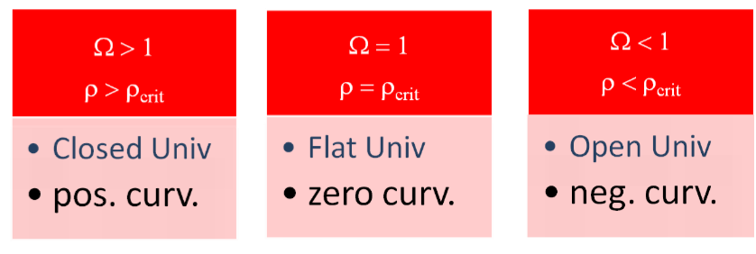
Gen Relativity: geometry
avg mass content
“Critical density” ρ_{crit}c²≈(2.5×10⁻³eV)⁴/(ℏc)³ as the standard:
Ω = (ρ /ρ_{crit}), Ω_{BM} = (ρ_{BM} /ρ_{crit}) ≈ 0.04
(Ω_{BM} < 1) negatively curved universe? checking geometry…

Slide 14
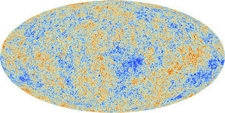
Cosmic Background Radiation = “after-glow” of big bang
The irregularity reflects matter density fluctuation (primordial quantum effect?) = seeds of structure formation in later stages of cosmic evolution
CBR = Photons from “the last scattering”-- as all charged particles were bound into neutral atoms &
U became transparent to photons
Extraordinarily small 10⁻⁵ temperature irregularity confirming “cosmological principle”

Slide 15
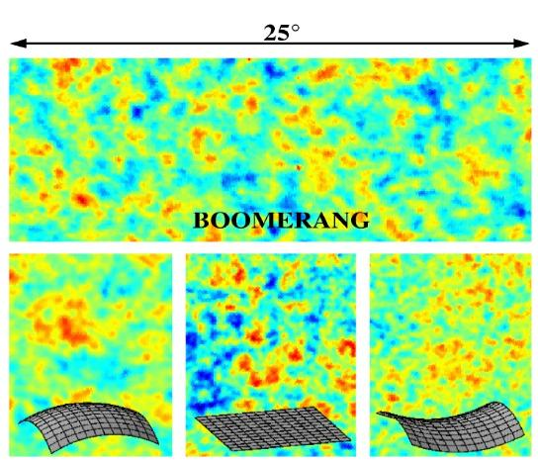
Cosmic Background Radiation anisotropy, 1st observed in 1990’s
Anisotropy of CBR =
baby picture of the universe
(If the universe were 100 yr-old,
this is its 1-day-old picture)
The geometry of the U
can be deduced from the observed pattern of anisotropy as it had traveled thru almost the entire age of the U

Slide 16
CMB anisotropy measurement showing a flat spatial geometry
GR: a flat universe must have density ρ = ρ_{crit} namely, (Ω = 1) >> (Ω_{BM} = 0.04)
a “missing energy problem” Exotic matter/energy to make up Ω = 1 ? Even with dark matter, Ω_{BM} +Ω_{DM} = Ω_{M} = 0.25 (< 1)

Slide 17
Cosmological difficulties in mid 1990’s
Missing energy problem Ω = Ω_{M} = 0.25 (< 1)
and
Cosmic age problem Ω = Ω_{M} age of flat U too short
generally accepted solution at present time:
We live in a Dark Energy (Λ) dominated universe
DE is the missing energy Ω = Ω_{M} + Ω_{Λ} = 1 ?
DE leads to an accelerating universe
slower expansion in the past → a longer age for the universe

Slide 18
DARK ENERGY = a uniform background that is accelerating the expansion of the universe
The name “dark energy” is neither descriptive nor accurate !
For example, black holes, neutrinos,… are all “dark” and
carry energy, but they are NOT counted as “dark energy” because they do not give rise to repulsion
Proper definition: “Equation of state”: p = wρc², examples: w_{M}=0, w_{R}=1/3 Dark Energy = system having negative pressure w < -1/3 leading to gravitational repulsion
The simplest form of dark energy….”the cosmological constant”

Slide 19
CC 1
GR naturally has such a feature
= the simplest form of “dark energy”
p = -ρc² namely, w = -1
Einstein’s original motivation: to obtain a “static universe” solution by a modification of his GR equation
(repulsion to counteract the familiar attraction)

Slide 20
CC 2
Einstein’s eqn G_{μν} = g_{N} T_{μν} math property
geometry matter/energy
NR weak field limit, it reduces to Newton’s equation
Einstein: a new term in geometry side G _{μν} - Λ g _{μν} = g_{N}T _{μν}
in order not to contradict the Newton’s law,
the new term Λ must be extremely small at normal distances
but, important on the cosmic scale
Hence the name: “the cosmological constant”

Slide 21
For easier physical interpretation of Λ
Move it, from the geometry side, to the energy side
G_{μν} - Λ g_{μν} = g_{N}T_{μν}
G_{μν} = g_{N}(T_{μν}+ g_{N}⁻¹Λ g_{μν} )= g_{N}(T_{μν}+ T^{Λ}_{μν})
T^{Λ}_{μν} = “the energy-momentum tensor of the vacuum”
Given g_{μν}can interpret T^{Λ}_{μν} in terms of ρ_{Λ}, p_{Λ}
Energy density ρ_{Λ}c² =Λ/g_{N} = constant
Pressure p_{Λ} = - ρ_{Λ}c² = negative (w = -1)

Slide 22
Grav repul
GR: not only mass, but also pressure = source of gravity
source ρ → Δφ = g_{Ν}ρ −1/r² force
ρ + p → Δφ = g_{Ν} (ρ +3p/c²)
Negative pressure => gravitational repulsion
(ρ +3p/c²) < 0 (namely, w<-1/3) => repulsion
For a Λ−dominated system
F_{Λ} = +Λ r instead of the familiar –1/r² force a repulsive force that increases with distance …can be relevant on the cosmic scale

Slide 23
Dark energy = energy that brings about gravitational repulsion The simplest DE = cosmological constant Their presence can counteract the usual gravitational attraction Instead of a decelerating universe a dark-energy-dominated universe has an accelerated expansion An accelerating universe

Slide 24
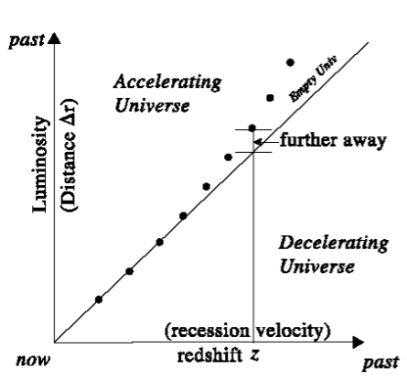
Evidence for an accelerated expansion? Examine the expansion history over cosmic time scale
_{Hubble diagram}
For an accelerating universe, expansion was slower in the past (smaller velocity for a given R). The Hubble curve bends upwards. A light source at given redshift on the Hubble curve, would be further out in distance (curve up, i.e. dimmer) than anticipated.
To see the bending of the Hubble curve, need to measure objects across enormous distances. Just such ‘standard candles’ have been found:Type-1a Supernovae

Slide 25
Surprising discovery
two teams announced in 1998: ►Supernova Cosmological Project (LBL: S.Permutter et al.) ►High-z Supernovae Search Team (Australian/American: A. Reiss et al.)
Distant SNe ≈25% less luminous than expected
Involves catching the light of exploding stars emitted billions of years ago
… and their intrinsic luminosity understood

Slide 26
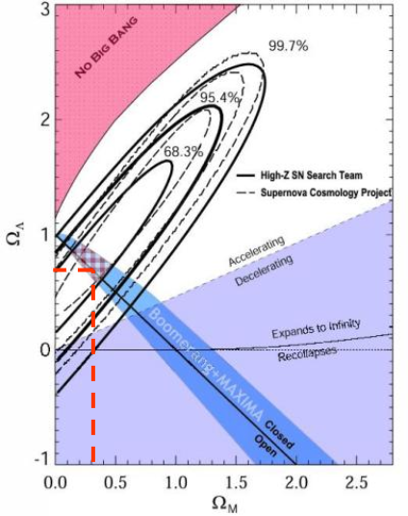
M/DE
Ω_{M} decelerated expansion, bends Hubble curve down Ω_{Λ} accelerated expansion, bends Hubble curve up
Just the missing ingredient for a concordant cosmology
Solving the missing energy problem
Ω_{M}+ Ω_{Λ} ≈ 0.25 + 0.75 =1.0
Solving the cosmic age problem
► t₀ ≈ 14 Gyr

Slide 27
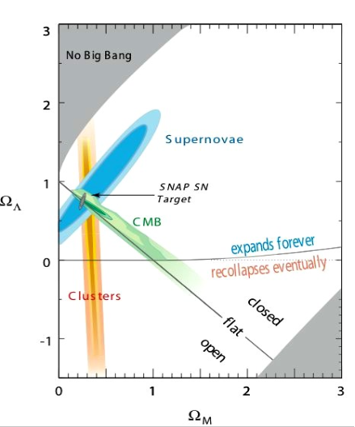
Matter/energy content and geometry of the universe have been measured in several ways:
Supernovae Hubble relation between recession velocity and brightness of Sne
CMB anisotropy = small irregularities in the background radiation left over from the Big Bang
Clusters = large-scale distribution of galaxies
3 types of estimates all agree

Slide 28
ΛCDM = Standard Model of Cosmology
Ordinary BARYONIC MATTER Ω_{ΒΜ} = 0.04
Exotic DARK MATTER Ω_{DM} = 0.21
Mysterious DARK ENERGY Ω_{Λ} = 0.75
Ω_{ΒΜ} + Ω_{DM} + Ω_{Λ} = 1 compatible w/ a flat universe
A model of the universe with these properties does a remarkably good job of fitting all the observational data
Hence, the generally accepted view:

Slide 29
Dark Matter / Dark Energy
Although we may know their properties, but don’t know their physical origin
What is Dark Matter?
We have some plausible ideas e.g. supersymmetric neutralinos, etc.
What is Dark Energy?
….. is truly mysterious!

Slide 30
The physical origin of DARK ENERGY?
The natural candidate is found in QFT: quantum vacuum energy ≠ 0 quantum-fluctuation
Has just the correct physical property of constant energy density and negative pressure….
However, the estimated size is completely off
Too large by 120 orders of magnitude !!
“Cosmological constant problem”

Slide 31
If the currently accepted interpretation of observational data as showing a DARK ENERGY dominated universe is correct….
….. to understand Dark Energy is one of the central problems for 21st century physics
Recall the claim: unlocking such secret will illuminate the nature of space and time and connect the quantum with the cosmos

