Slide 1
extra dimensions of spacetime
Theoretical lessons from Maxwell’s equations
Relativity
Gauge symmetry
Extra dimensions
Ta-Pei Cheng
5/2010 PSU

Slide 2
from Maxwell’s equations
Relativity, Gauge symmetry, … Extra dimensions(?)
Outline
Relativity = spacetime symmetry
SR: inertial coordinate frames
GR: general coord frames => gravitational field theory
(1+3)-dimension tensor formalism
Gauge symmetry – local symmetry in charge spaces
Mawxell’s theory as prototype gauge theory
Strong, weak & EM interactions = gauge int’ns
Extra dimension theory - a historical introduction
“The Kaluza-Klein Miracle”: derivation of Maxwell’e eqns from 5d GR g gauge symmetry = spacetime sym of compactified extra dim
Speculation: discovery of extra dim at LHC??
Math formalism
indispensible for the study of higher dim

Slide 3
relativity
Maxwell’s eqs have Lorentz symmetry
Unchanged under Lorentz transf

Slide 4
Relativity = coordinate symmetry (from SR to GR)
SR = the symmetry with resp to transf among inertial frames of reference
GR = the symmetry with resp to general coordinate transf (include accel frames)
Equiv Principle: accelerat’n = gravitat’n, GR = relativistic field theory of gravity
Electromagnetism
field eqn: Maxwell’s eqns
eqn of motion: Lorentz force
GR field : curved spacetime
field eqn: Einstein equation
eqn of motion: geodesic eqn

Slide 5
relativity
Tensor formalism of GR
Will show: a higher dim version contains Maxwell

Slide 6
Gauge symmetry
H. Weyl, V.Fock, F.London (1918-28): Gauge principle
To turn global U(1) symmetry charge consv
into local U(1) symmetry
require covariant derivative
Thus, the requirement of gauge symmetry essentially determines
the form of electromagnetic interaction (useful for finding new…)

Slide 7
Gauge symmetry
Gauge symmetry as guide to the discovery of
modern particle physics theories
Generalizing commutative U(1) symmetry of EM
to non-commutative symmetries
Strong, weak & EM interactions are all gauge interactions
What is the origin of these gauge symmetries?
What are these “charge spaces”?

Slide 8
Extra dimensions
Seeking a geometric theory that unifies Maxwell theory with GR
Theodor Kaluza (1919): electromagnetism can be derived from 5d GR
Unified (i.e., combined) in one higher dim theory?
by extending indices
5d spacetime

Slide 9
Extra dimensions
The Kaluza-Klein miracle:
The principle of GR applied to a 5d spacetime having a KK metric
Not only recovered the 4d general relativity
But also the Maxwell’s theory came out as a “by-product”!
Furthermore, 4d Lorentz force law for a charged particle followed
from the 5d gen relativistic equation of motion (geodesic equation)

Slide 10
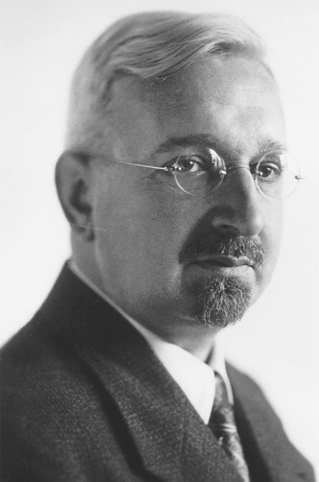
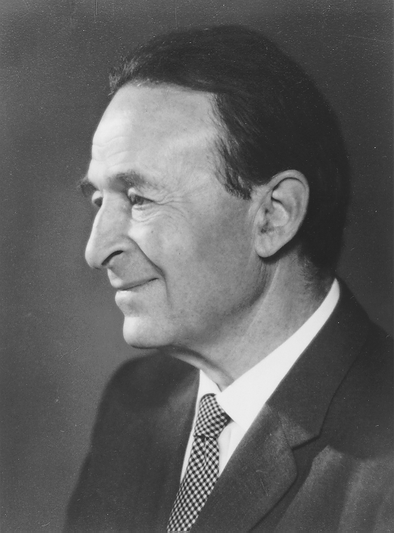
Extra dimensions
In physics, at least, miracles need rational explanation
Need to explain the Kaluza-Klein miracle
(1919) Kaluza discovered the miracle; (1925-28) Klein explained it
Theodor Kaluza
(circa 1940)
Oscar Klein
(circa 1950)

Slide 11
Extra dimensions
The physics behind the KK metric
Clue: Recall that EM can be determined by gauge symmetry
Gauge transformation turns out to be a particular spacetime transform’n in higher D
That gauge sym having a 5D geometric origin goes a long way in explaining the KK miracle

Slide 12
The physics behind the KK metric
Extra dimensions
Recall the key feature:
The fields are indep of the extra dim coord x⁴
Strange?! Postulate extra dim with indices (0,1,2,3,4), yet
the fields are not allowed to depend on x⁴ !

Slide 13
Extra dimensions
Kaluza (the mathematician) was silent on the physical reality of the extra dimension
Oscar Klein (the physicist) proposed that the extra dimension was real…
Non-observation, because it’s extremely small --- the extra D was “curl up”.
The extra (4th) spatial dimension is compactified to a circle (radius R)
Geometry: M₅ = R⁴xS¹ Every point in the observed 3d spatial space
is actually a circle.
A hose, seen at a distance as a line (1d), is in reality composed of a series of 2d circles.
Klein, besides finding the coord space origin of gauge symmetry, also using (then new) quantum mechanics
deduced
The physical consequence of a compactified dimension

Slide 14
Extra dimensions
Quantum fields in a compactified space

Slide 15
Extra dimensions
The signature of extra-dimension in 4d spacetime:
a tower of KK particles, with increasing masses (n/R),
having identical spin and gauge quantum numbers

Slide 16
Extra dimensions
The signature of extra-dimension in 4d:
a tower of KK particles, with increasing masses,
having identical spin and gauge quantum numbers
This explains the mystery of Kaluza’s assumption
of x⁴-independent fields

Slide 17
More recent activities
Abelian gauge theory = curled-up single extra dimension
Non-Abelian gauge theories = curled-up multiple extra dimensions
The superstring/M theory : five superstring theories and supergravity (gauged supersymmetry). The only known attempt at quantum gravity theory, free of divergence problems.
Must have 10 dimensions to be self-consistent. …huge number of consistent compactification ways (leading to the SU(3)xSU(2)xU(1) SM fields) -- but no obvious criteria to select …
Speculation: “landscape of theories”.
difficult study of topology and differential geometry
Plausibly, extra dimensions curled up due to quantum gravity (= quantized spacetime)
Hopeless to observe?

Slide 18
Theory of “large extra dimensions”
Gravity in space with extra dimensions
Gravity in space with extra dimensions
Speculation of a large extra dimension
1/R = O(10³GeV) = electroweak scale, instead of Planck O(10¹⁹GeV).
Gravity coupling G* not so small?
Gravity observed in 3d space is feeble (G<<G*) because extra dimensions are “large”.
Not ruled out by direct or indirect observational or experimental tests!
Long-shot possibility:
Finding KK particles
in LHC experiments

Slide 19
summary
Lessons from Maxwell’s Equations:
Relativity, gauge symmetry (and extra-dimension ?)
Relativity: Physics arena = spacetime; gravity = structure of spacetime
Gauge symmetry: All non-gravity interactions are gauge interactions
Extra dimensions of spacetime (?)
Kaluza-Klein => spacetime sym of compactified extra dim = gauge symmetry
EM+others as “gravity interactions” of extra dim Unification of forces (?)
Physical manifestation of extra dim in 4D spacetime = towers of KK states
Candidate theories of quantum gravity involve several extra dimensions (?)
While m_{KK} = O(10¹⁹GeV) more plausible expectation,
large extra dim: m_{KK} = O(10³GeV) not ruled out!

Slide 20
Theory of “large extra dimensions”
2
1
2
1
2
δ d
Mass spread out in extra dim (size R)
2
2
3d

